Slide 1
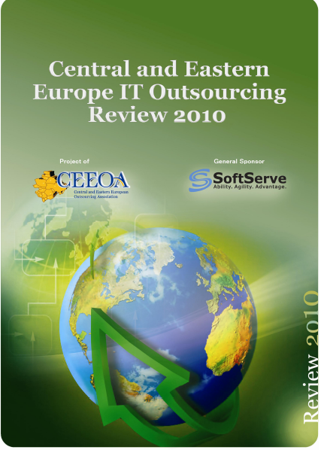
Central and Eastern Europe IT Outsourcing Review 2010
Mary Brandon
VP Marketing, SoftServe, Inc.
Dec-14, 2010
CEEOA Research Findings

Slide 2
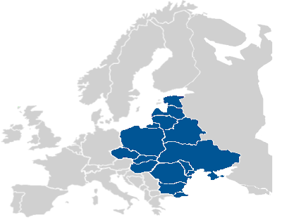
Goal
The main objective of this research was to create an annual impartial view of the state of the IT outsourcing services industry in the CEE region.

Slide 3
Methodology
The research was conducted from February to July 2010.
The respondents came from 246 companies that participated through online surveys.
Respondents included:
  Large companies operating in the outsourcing services market
  Outsourcing associations
  Software development associations in the 16 countries that comprise the CEE region, as well as members of the CEEOA.

Slide 4
Methodology
The research included verbal interviews with representatives from 32 companies and 25 representatives of associations.
Answers on the market volume assessment and the main development trends in the IT outsourcing industry in the region were provided by market experts. Experts biographies are detailed within the report.

Slide 5
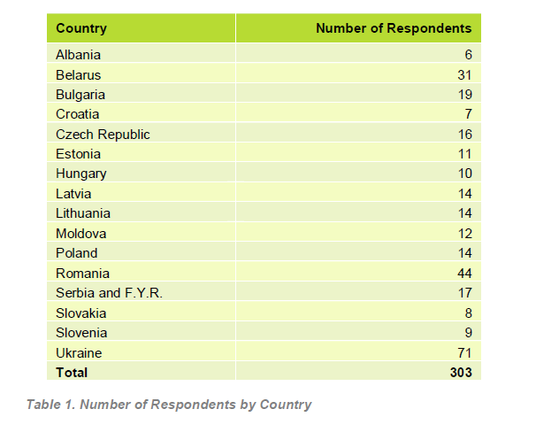
Number of Respondents by Country

Slide 6

Number of IT Outsourcing Companies
The results of the survey revealed that nearly 4,500 companies operate in the industry of IT outsourcing and software development services in the 16 countries of the CEE region.

Slide 7
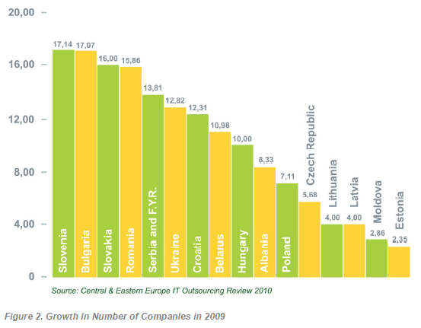
Growth in Number of Companies
Among the leading countries, Slovenia and Bulgaria achieved the highest growth with 17% for the number of new companies formed.
Overall there was an average of 10% growth in the region.

Slide 8
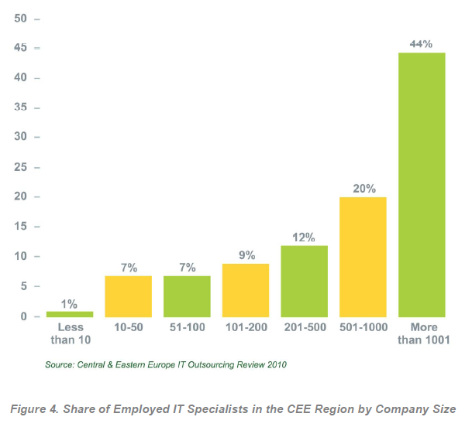
Employed IT Specialists
85% of IT specialists in the CEE region work in companies with more than 100 employees.
44% of IT specialists in the CEE region work in companies with more than 1,000 employees.

Slide 9
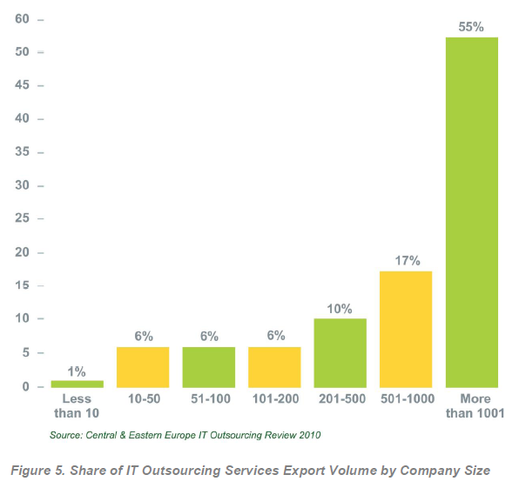
IT Outsourcing Service Export Volume
81% of IT outsourcing and custom software development services are produced by companies with more than 200 employees.
55% of IT outsourcing and custom software development services are produced by companies with more than 1,000 employees.

Slide 10

Number of IT Specialists
In 2009, the number of IT specialists employed in companies providing IT outsourcing and software development services in the CEE region reached 95,000.
Romania led in growth in the number of IT specialists with 12.33%.
Ukraine followed with 9.51% growth.

Slide 11
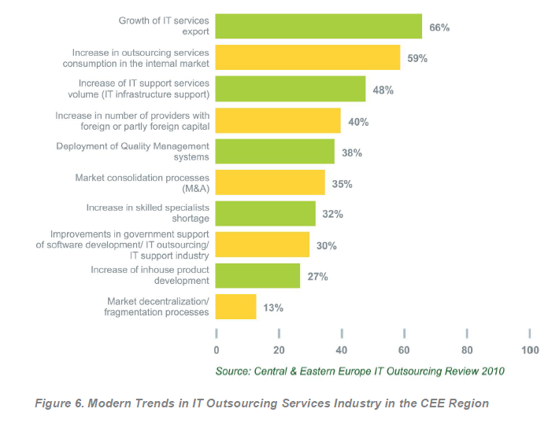
Modern Trends in Outsourcing
The three top trends in outsourcing included:
  Growth of IT services exported (66%)
  Increase in outsourcing services consumption in the internal market (59%)
  Increase of IT support services volume (48%)

Slide 12
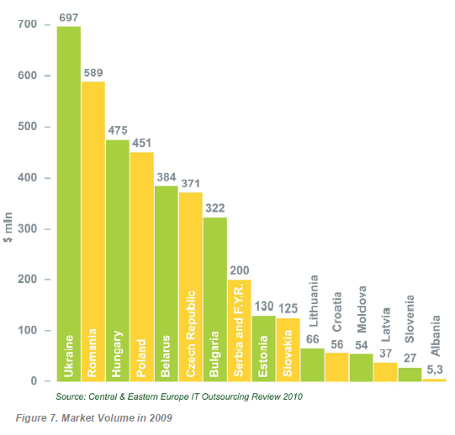
Market Volume 2009
The general volume of IT outsourcing and custom software development services exported from the CEE region reached USD $4 billion in 2009.
The largest growth took place in Ukraine and Romania.

Slide 13
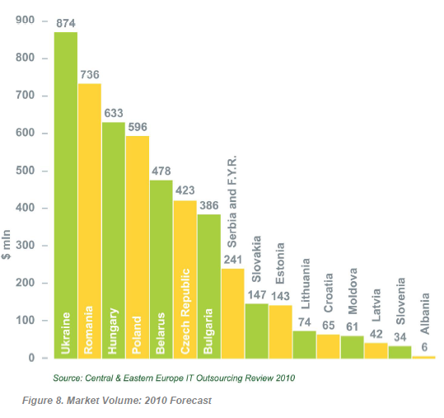
Market Volume 2010 (forecast)
According to the forecasts of those surveyed, the volume of IT outsourcing and custom software development services exported from the CEE region will reach approximately $5 billion in 2010.
Respondents from all countries are forecasting between 10%-30% growth.

Slide 14
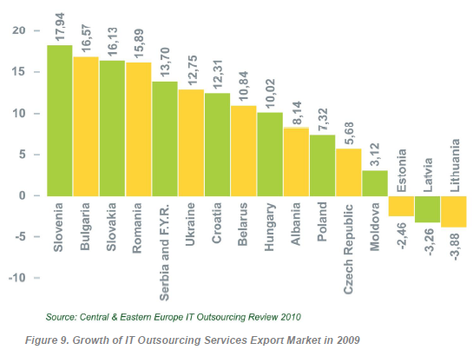
IT Outsourcing Services Export Market Growth 2009
Slovenia, Bulgaria, Slovakia and Romania showed the highest export growth of IT outsourcing services with between 15% and 17%.

Slide 15
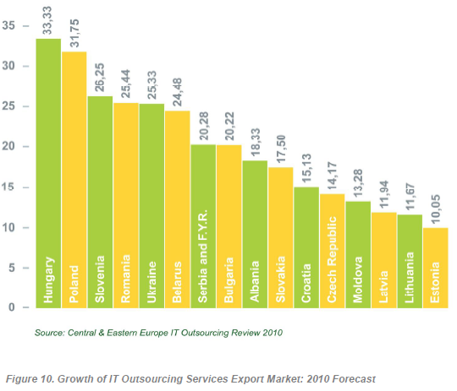
IT Outsourcing Services Export Market Growth 2010 (forecast)
According to the forecasts of those surveyed, the IT outsourcing services export market growth will come from Hungary, Poland and Slovenia in 2010.

Slide 16
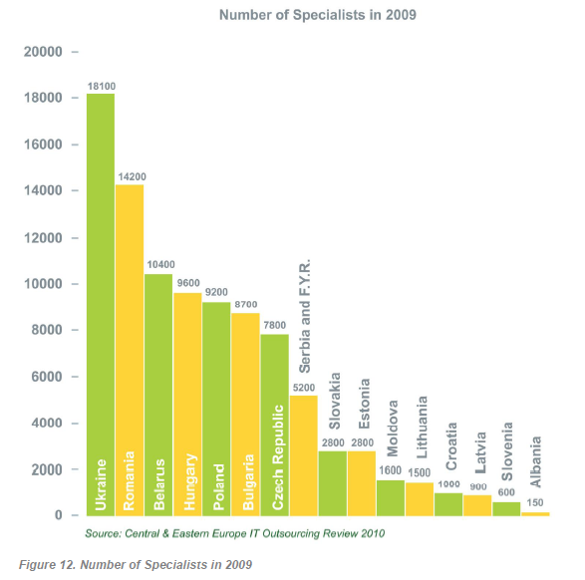
Number of Specialists 2009
In 2009, almost 95,000 IT specialists were involved in the IT outsourcing and custom software development services industry in the CEE region.
The leading countries (Ukraine, Romania, Belarus, Hungary, and Poland) accounted for 75% of all specialists in the region.

Slide 17
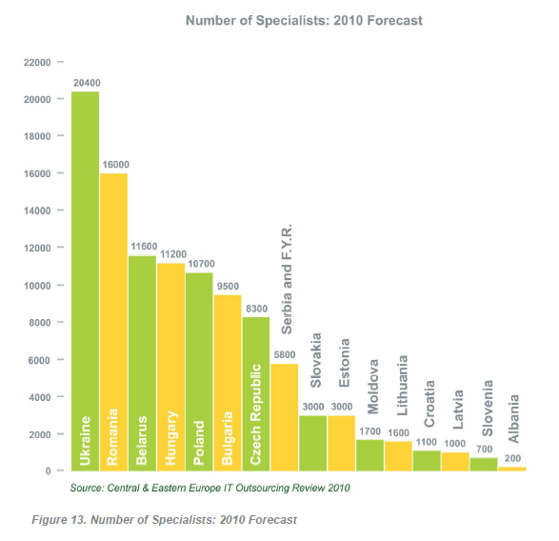
Number of Specialists 2010 (forecast)
The forecast for 2010 predicts Ukraine as the leader in IT Specialists with 20,400, followed by Romania with 16,000 IT Specialists.

Slide 18
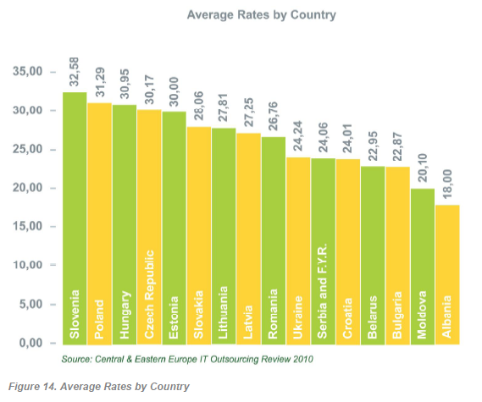
Service Rates
At the end of 2008 and into the beginning of 2009, the service rates charged by companies dropped slightly in order to retain current clients and to win new projects with the resources available.
But since the spring of 2009, increased demand for services, led the growth in rates to resume.

Slide 19
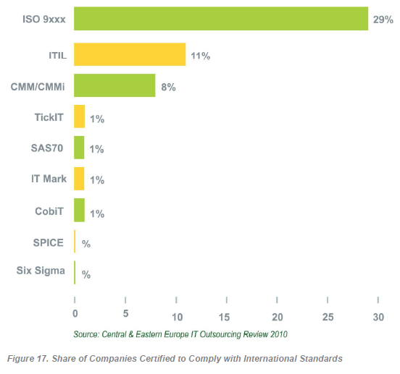
International Standards Certification

Slide 20
Experts View

Slide 21

IT Outsourcing Trends
The following trends were observed in all countries of the CEE region:
Growth of IT services exports
Increase in outsourcing services consumption in the internal market
Growth in the number of providers with foreign capital or partly funded by foreign capital
Growth in IT support services volume (IT infrastructure support)

Slide 22

IT Outsourcing Trends for Vendors
Creating new products and solutions to increase sales revenues.
Big and small suppliers are focusing on new service models
such as cloud computing, managed services and SaaS.
Integration of IT and telecommunications solutions.
Using service models based on economies of scale: having a large number of customers, low sales revenue per customer and low costs of sales per customer.

Slide 23

IT Outsourcing Trends for Customers
Cost pressure and limited budgets for IT investments.
Need for security solutions.
Need for flexible solutions.
Multi-site collaboration, a need for products and services supporting home office and mobility solutions.

Slide 24
The main development trends on IT outsourcing services market
Companies are moving from staff augmentation models to broader managed services engagements.
Companies are sourcing more complex tasks and functions to providers.
Companies have investigated and are focusing on Cloud Computing, SaaS and Web 2.0 technologies.
The main drivers in the future will be innovation and time to market.

Slide 25

Attitude towards Outsourcing
Outsourcing has become the “normal”, an expected part of a CIO’s provisioning model for IT.
Companies are not just looking to cut cost – they are looking to improve their business processes and global operations.
Outsourcing buyers are increasingly looking at service providers as true business partners who help navigate through the new business challenges.

Slide 26

CEE region as a cluster of IT outsourcing services providers
Advantages:
Historically strong engineering tradition and technical training with relatively low turnover.
The business culture is close to those of America and Europe.
Young, dynamic, highly-motivated people speaking multiple foreign languages.
The geographic and cultural proximity with buyers’ locations.
A stable and advanced legal and infrastructure framework compared to competing locations.

Slide 27
CEE region as a cluster of IT outsourcing services providers
Disadvantages:
Lack of understanding of Western business drivers and strategies.
Wages and salaries in the CEE countries are rising quicker than those in Western Europe.

Slide 28
Research Conclusions
In 2009, the software development and IT outsourcing services provider industry in Central and Eastern Europe successfully overcame all of the challenges of the recession of 2008 and resumed its previous trajectory of growth.
During the recession of 2008 and into 2009, no significant bankruptcies, closures or IT outsourcing company failures were reported.

Slide 29
Research Conclusions
The industry used the recession time to reorganize internal business processes within companies, to optimize costs, and to further develop more qualified operational business management processes.
Such rapid recovery by the industry, and resumption of its previous growth rates, are testament to the strength and solid prospects of the business mode.

Slide 30
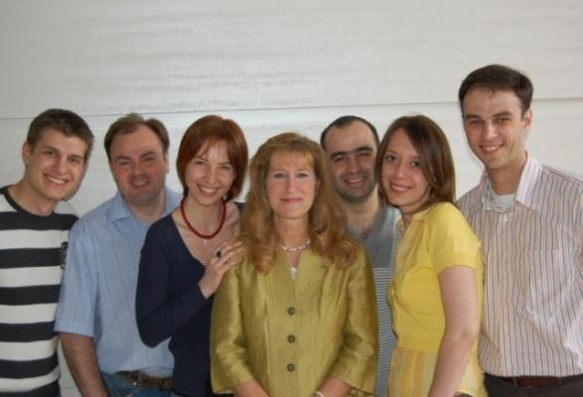
About SoftServe

Slide 31

SoftServe
Founded: 1993
A leading global provider of proven high quality software development, testing and consulting services.
Serving independent software vendors and software-enabled enterprises.
Providing the ability to accelerate our client’s growth and expand their product offerings far beyond internal capabilities.

Slide 32





Background
Awards
Experience: 17 years of industry experience
Employees: 1500+ professionals
Projects: 2000+ successfully delivered projects
Clients: 60+ Active clients

Slide 33
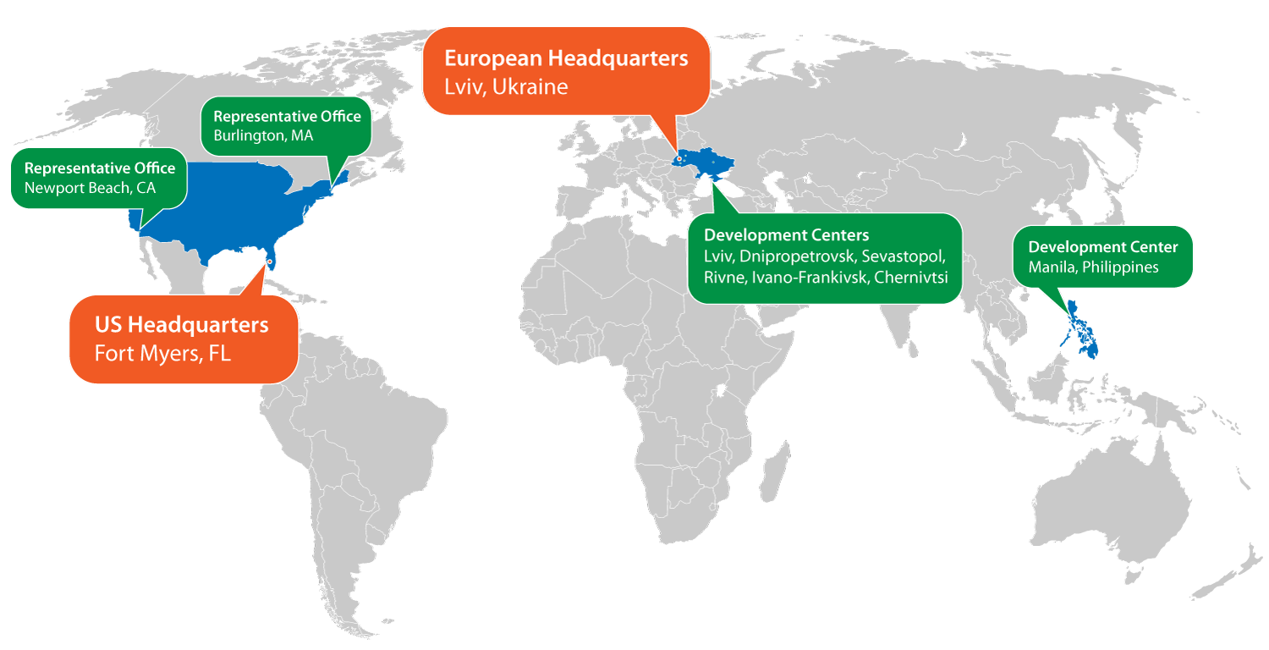
Locations

Slide 34

Service Offerings

Slide 35



SaaS/Cloud Services
CloudExplorer…
This strategic, exploratory service assists businesses with creating a SaaS/Cloud strategy and roadmap.
CloudEnhancer…
This service provides businesses with assessments and recommendations for existing SaaS/Cloud applications that require technology enhancements and optimization.
CloudEnabler…
This enabling service assists businesses with the SaaS/Cloud application development,
deployment, maintenance and support.
Notes:
These are SoftServe’s three solution offerings.

Slide 36





Mobility Services
MobileVIEW
This strategic service assists businesses with creating a mobility strategy and roadmap.
MobileMAP
This assessment service reviews current business processes to map out the best processes suited for a mobile strategy and provides recommendations on the benefits and risks.
MobileMOVE
This enabling service assists businesses in the development and deployment of applications from desktops and laptops to mobile technology, platforms and devices.
Notes:
These are SoftServe’s three solution offerings.

Slide 37
Software Development Services
SoftServe created a SDLC’s playbook for clients to establish necessary processes and address any organizational gaps to provide best practices and deliver state-of-the-art software development to their customers.
The services we provide include:
Project Planning | Integration
Requirements Definition | Implementation
Design | Quality Control/Testing
Development | Maintenance/Support
Design Architecture

Slide 38
Value-add Consulting Services
Our value add consulting services are designed to establish a strategic outsourcing partnership with our clients.
The initial services focus around the business goals of the client, followed by solution definition sessions that lead to effective SDLC implementations. These include:
  SmartStart Suite
  SaaS and Mobility strategy and roadmap services
  Feasibility Studies
  User Experience Design
  Application Assessment and Optimization

Slide 39
It’s All About Our Clients and Their Success…
Staffing Flexibility
Clients choose when and how to increase their staff as their business needs grow by letting us provide what they need, when they need it.
Agile Development
Clients get their products to market faster and reduce costs when we introduce flexibility, adaptability and productivity into their software development process.
SoftServe Key Benefits
Quality Management
Clients receive the highest quality products that are more competitive in the marketplace as a result of our best practices in rigorous testing and quality control.
Exemplary Customer Service The Client always comes first. Our on-shore/off-shore approach allows us to better consider their time and service needs.

Slide 40
Conclusion
SoftServe was pleased to sponsor the Central and Eastern Europe IT Outsourcing Review 2010. The research has impacted our strategic focus and roadmap for 2011.
Our vision:
  Continue to develop the highest quality software development resources
  Reinforce our investments into SaaS/Cloud, Mobility and SDLC solutions.
  Expand the development of innovative value-add consulting services.
The research supports the market need in this direction and SoftServe is committed to advancing its leadership in these domains.

Slide 41

A Great Team to Work with…
SoftServe, Inc.

Slide 42
Contacts
Thank You!
US Headquarters
12800 University Drive, Suite 250
Fort Myers, FL 33907, USA
Main Tel: 239-690-3111
Main Fax: 239-690-3116
Europe Headquarters
52 V. Velykoho Str.
Lviv 79053, Ukraine
Tel: +380-32-240-9090
Fax: +380-32-240-9080
VP Marketing: Mary Brandon
Telephone: 239-322-1243
E-mail: mbrandon@softserveinc.com
www.softserveinc.com

