Slide 1

A Sponsor of the CEE IT Outsourcing Review in Ukraine
Ukraine – An Emerging Software Outsourcing Destination
www.eleks.com
Notes:
Hello everyone
My name is Olha Markova, I represent ELEKS Software, one of the largest software services companies in Western Ukraine.
First of all I want to thank Central and Eastern European Outsourcing Association for conducting such researches from year to year. Their reports are the comprehensive source of information available today about IT outsourcing industry for the Central and Eastern European region. And Eleks Software is very proud to be the sponsor of this year research in Ukraine.

Slide 2
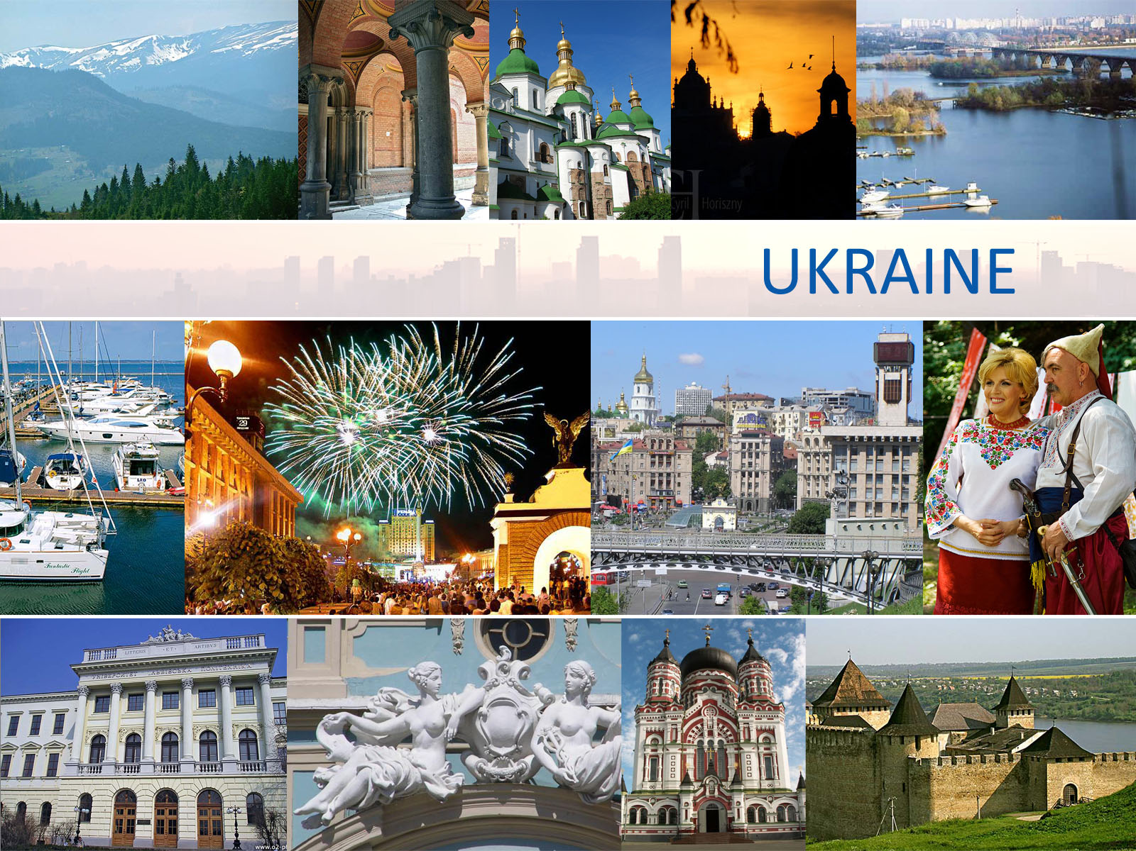
Notes:
My presentation today will be devoted to Ukraine as an emerging software outsourcing destination. I am going to start with an overview of Ukraine’s IT outsourcing industry and then focus on one of its largest software development regions – Lviv.

Slide 3
















Ukraine - One of The Largest Countries in Europe
The second largest European country
Population: 45.7M (#27 in World)
GDP in PPP: $ 290B
GDP per capita in PPP: $ 6,300
Labor force: 22.15M
Developed ex-Soviet
economy (World’s #34)
Large, highly-educated,
low-cost work force
Lviv
Kyiv
Notes:
Ukraine is the second largest European country – just after Russia. Located in Eastern Europe, Ukraine has a fairly large population with roughly 48 million people. The capital of Ukraine is picturesque Kyiv.
Ukraine was a reluctant member of the former Soviet Union. During the Soviet period, its economy was the second largest in the entire country. Ukraine was an important industrial, agricultural and engineering region.
Modern-day Ukraine has been independent since August, 1991. After the collapse of the Soviet system, Ukraine was free to become an independent state. Following a slow start, Ukraine transitioned to market driven economy
>> and has been a quick study in the financial ways of the West.
Since 2000, Ukraine’s economy has grown rapidly. Today, it is ranked as 34th in the world with a GDP estimated at $ 290 B.
Ukraine maintains close economic, political, and cultural ties to many European countries.
For the last ten years, Ukraine has displayed strong export-based growth, specifically in industrial manufacturing. Ukraine produces many different types of transportation vehicles and has a thriving aircraft and aerospace industry.
Since 2008, Ukraine has been a proud member of the World Trade Organization.
Ukraine is seeking a close relationship with the EU which is its largest trading partner. The country targeted 2017 as the year for Ukraine’s entry into the EU.
It’s worth to mention that Ukraine will be a host country for the European Football Championship 2012. Ukraine and its co-host Poland will be the first Eastern European countries to stage one of the world’s top sporting events. Certainly, being a joint organizer of the Championship, provides a great opportunity for Ukraine to boost its economic and geopolitical fortunes.

Slide 4
Overview of Ukraine’s IT Outsourcing Industry
Ukraine represents the largest IT Outsourcing industry in Eastern Europe
IT Outsourcing industry growth rate for 2009 – 13%
More than 900 IT companies
18,000+ specialists involved in IT Outsourcing
Ukraine has more than 800 universities and colleges
Majority of Ukrainian IT specialists (est. 70%) work for American or European customers
A number of Government initiatives introduced to support and promote the Ukrainian IT industry
Notes:
Recent research conducted by Central and Eastern European Association has shown that Ukraine is the largest exporter of software outsourcing services in Central and Eastern Europe.
Ukraine was ranked as the top country in the region in volume of IT outsourcing service export, in numbers of IT experts and IT outsourcing companies.
In 2009, the volume of IT outsourcing services exported from Ukraine was estimated at almost $ 700 M coming from more than 900 companies and 18,000 IT specialists.
According to experts, one of the most important factors contributing to further development of Ukraine’s IT outsourcing industry is its highly-educated and skilled workforce. Ukraine has long been known for its historically strong engineering tradition and technical training. It’s a well-known fact that during Soviet rule, higher education was focused on engineering specialties. And this legacy still remains strong in Ukraine’s educational system as they churn out some of the world’s top IT talent.
Another key factor that affects development of IT outsourcing industry in Ukraine is direct government support and initiatives. The government realizes the potential and the role of the industry in the entire economy. A number of laws, including a law on intellectual property rights protection, were adopted to favor the growth of IT sector.

Slide 5
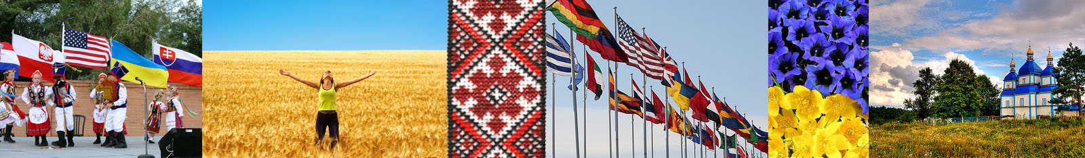
Industry Acknowledgement
Ukraine is listed among:
Top 10 countries with the most certified IT professionals (Global IT IQ Report by BrainBench)
Top 30 Outsourcing Destinations
(Gartner, 2007-2008)
Top 50 Emerging Global Outsourcing Destinations
(Global Services and Tholons, 2009)
Ranked 11 in Top 100 Leading Countries in the area of IT Outsourcing and High-Tech services (Global Services 100 List, 2010)
Notes:
For the last decade, Ukraine has proven to be a reliable destination for organizations that decide to use outsourcing services.
Ukraine is one of the countries that has got the most number of certified IT professionals.
Ukraine was named among top 30 outsourcing destinations in the world by Gartner in two years in a row – 2007 and 2008. In 2009 Ukraine and specifically Kyiv got recognition as one of the top 50 emerging global outsourcing destinations by Global Services and Tholons.
This year Ukraine has been named among 20 leading countries in the area of IT outsourcing and High-Tech Services in the Global Services 100 List. Ukraine is listed # 11 ahead of Russia, Belarus and Poland.

Slide 6

Ukraine’s IT Outsourcing Market
Growth in 2009
 | 2008 | 2009 | 2010 Forecast
Market Volume | $ 530 M | $ 697 M | $ 874 M
Number of Companies | 850 | 940 | 1,000 +
Number of IT Specialists | 14,400 | 18,100 | 20,400
* Source: CEE IT Outsourcing Review 2010
Notes:
The Ukrainian IT outsourcing market continues to grow against the backdrop of the recovering global economy and rising demand for software services. It has grown 32% in revenues from $530 M in 2008, to $697 M in 2009. Its forecasted value for 2010 is estimated at $ 874 M. To keep pace with demand, it is expected that the number of IT specialists will climb nearly 42% in the same 3 year period from 14,400 to almost 21,000 specialists.
The key export markets for Ukrainian software outsourcing services are the United States, Germany, Scandinavia, France, UK and other European countries.

Slide 7
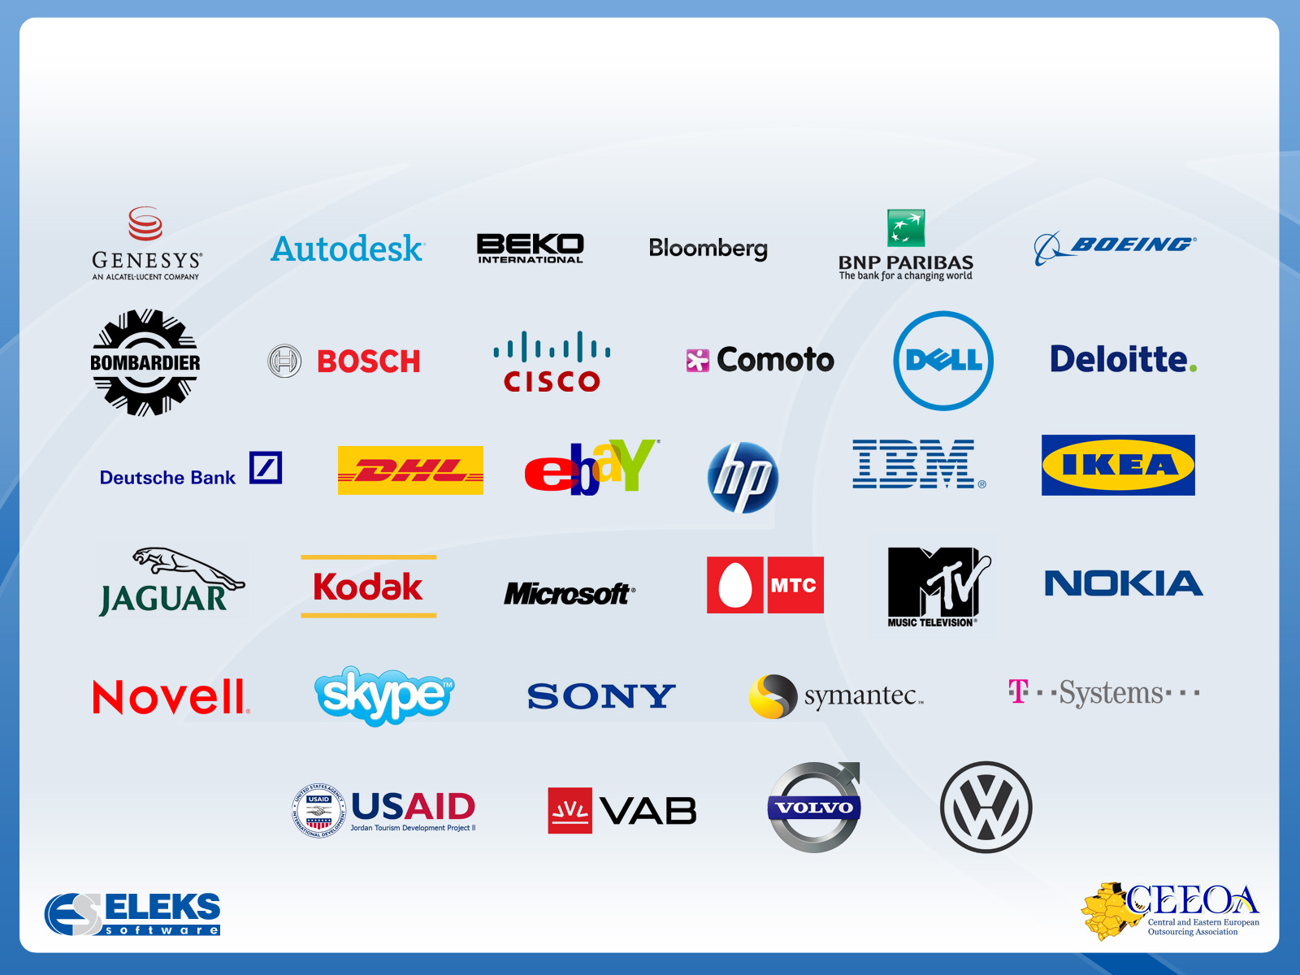
Sample Customers of Ukrainian
Outsourcing Services
Notes:
Shown here are sample customers of outsourcing and software development services provided by Ukrainian IT companies. Most are large, multi-national corporations. Many are household names around the world.
Typical services that are generally provided by Ukrainian software firms include:
Custom software development
Quality assurance and testing services
Embedded software development
Web solutions, e-commerce portals
There is also increasing demand for Localization services as more and more companies offer their products to increasingly accessible global markets.
On this last note, here is an interesting fact. At the Localization World Conference held in Seattle, an international gathering of Localization experts held this past October, the keynote speaker from Cisco noted that Ukraine is now seen as one of localization hotspots in the world.

Slide 8
Main Advantages of Ukraine as the Outsourcing Destination
Mature IT / BPO market that continues to develop rapidly
Large pool of highly-skilled specialists, top-notch technology talent
Strong educational system, large number of universities, scientific schools and R&D centers
Good command of English
Well-developed infrastructure
Economics and politics transformations towards Western business models
Cultural and geographical proximity to Western Europe
Significant cost reductions, including labor costs
Notes:
There is a number of reasons why Ukraine is such an attractive region.
The IT outsourcing industry in Ukraine is rather mature and continues to develop quickly.
Ukraine offers a large pool of highly-skilled professionals and brilliant minds in information technology fields.
Ukraine’s educational system is capable of filling the high demand for large numbers of technical specialists with historically strong engineering traditions.
The predominate language of technical professionals is English.
Information and computer technology infrastructure is well-developed, including telecommunications and Internet services.
Such factors as continuous transformations of economy towards European business model, close cultural match and possibilities for significant cost-reductions make Ukrainian software services providers a good choice for Western firms willing to move their software development to our country.

Slide 9
Key Outsourcing Centers in Ukraine
City | Population, million | Part of outsourcing industry resources (mostly IT), % | Average salary relative to Kyiv, %
Kyiv | 4.0 | 42 | 100
Kharkiv | 2.5 | 20 | 85
Lviv | 1.3 | 11 | 75
Dnipropetrovsk | 2.0 | 8 | 80
Odessa | 1.8 | 4 | 80
Other |  | 14 | 70
* Source: www.ceeoa.org
Notes:
This slide provides the data for the key outsourcing centers in Ukraine.
The largest technical center is Kyiv, the capital, with 42% of all IT industry resources in the country. The second is Kharkiv. While Kyiv and Kharkiv are the leading regions that combined have the most of resources, Lviv, Dnipropetrovsk and Odessa are being considered more attractive outsourcing destinations with their lower costs that average 20 – 25% lower than those of Kyiv.

Slide 10



Notes:
I would now like to focus a bit more on one of the largest software development centers outside of Kyiv – Lviv. Steeped in culture and rich tradition, in September, 2006, Lviv celebrated its 750 ^{th} anniversary. This city is a historic gem that was hidden from West at the Soviet time. However its historic value was finally recognized in 1998 when Lviv was named a UNESCO World Heritage site. This city is also the home to ELEKS Software, as well as a number of other leading Ukrainian software services firms.

Slide 11

Lviv – The Capital of Western Ukraine
One of the largest economic, scientific and technological centers in Ukraine
Strong historical and cultural
ties with EU countries
The Ukrainian city with the
strongest Western mentality
Main industries: tourism,
food, chemical, construction,
electronics, engineering, and IT
Kyiv
Lviv
Notes:
Lviv is the principal city in the Western Ukraine. It’s one of the largest economic, political, scientific and cultural centers in the country.
The history of the city is very rich and concerned with the history of many European countries such as Poland, Hungary and Austria. Because of its close ties with Western countries at all the times, Lviv is truly believed to be the Ukrainian city with the strongest Western mentality.
Located roughly in the midpoint of Europe, Lviv is the center of trade and commerce. Major trade roads from Western Europe and East have led to its sustainable economic development. Many industries are represented there, the main are tourism, food, chemical, construction, engineering, electronics and information technology.

Slide 12


Lviv – The Capital of Western Ukraine (2)
The leading educational center in Ukraine with almost
40 universities and institutes
Strategically located in the very center of Eastern Europe
Convenient airline connections: Munich – 2 hours, Warsaw – 1 hour, Vienna – 1.5 hours (direct); New York (through Warsaw) – 10 hours
In 2009, Lviv was named the Best Ukrainian City To Live In (‘Focus’ magazine)
Notes:
Lviv is a leading educational center in Ukraine and one of the largest in Central and Eastern Europe. There are nearly 40 universities and institutes that prepare highly-educated resources for various industries. Lviv’s legacy of a Research and Development center in electronics and IT at the time of the Soviet Union brought in the tradition of strong technical schooling.
A considerable scientific potential is concentrated in the city: by the number of doctors of sciences, candidates of sciences and scientific organizations, Lviv is the forth city in Ukraine.
Lviv is geographically located in the center of Eastern Europe and is only 70 km from the Polish border. International airlines connect Lviv to the world. Warsaw is one hour flight, Vienna – 1.5 hours, Munich – 2 hours.
In 2009, the Ukrainian magazine Focus assessed Lviv as the best Ukrainian city to live in.

Slide 13
Lviv - One of The Largest Ukraine’s IT Centers
Lviv is one of the three largest software development centers in Ukraine
11% of all Ukrainian IT specialists work in Lviv
50+ IT companies. Several of the larger players influence the local market
The largest: Softserve, GlobalLogic, ELEKS Software, Lohika, EPAM
Average salaries in Lviv are approx. 25% lower than those in Kyiv
Low employee turnover
One of the top Emerging IT/BPO Destinations in the world
(KPMG Report 2009)
Notes:
Being the third largest SWD center in the country, Lviv has gathered 11% of all IT resources in Ukraine. Most of them have profound knowledge and skills in computer sciences and engineering. Often, experienced professionals are also equipped with strong management skills.
There are more than 50 software services companies. The largest are SoftServe, GlobalLogic, Eleks Software, Lohika and EPAM.
Average employee turnover is relatively low. Specialists prefer working for the industry leaders. Labor costs are 25% lower than in the capital.
In 2009 the city of Lviv was recognized one of the top emerging IT/BPO destinations in the world.

Slide 14

Education Facilities in Lviv
  Ukraine is ranked #32 in Education on the 2009 Legatum Prosperity Index of 104 countries – ahead of India, China and other key outsourcing destinations
Lviv is a leading educational center in Ukraine and one of the largest in Central and Eastern Europe:
    38 higher education institutions
    130,000 students
    15,000 highly educated graduates each year, specializing in IT, Engineering, Applied Sciences, and Foreign Languages
Notes:
For the longest time, Ukraine has placed education as a high priority – particularly in the fields of math, science and technologies. This long-standing tradition has allowed Ukraine to rank 32nd in education in the world – ahead of India, China and other popular outsourcing destinations.
Lviv is an important educational center of Ukraine. It is home to three major universities and a large number of smaller schools of higher education. There are eight institutes of the National Academy of Science of Ukraine and a lot of research institutes.
Lviv has a large pool of talented students that is nearly 130,000. Every year, Lviv’s universities and institutes supply roughly 15,000 graduates with a superior knowledge in applied sciences, engineering and computer technology.
The largest number of young technical graduates comes from the Lviv National Polytechnic University and Ivan Franko National University of Lviv. The latter is considered to be one of the oldest in Central Europe.

Slide 15
Key Factors that Make Lviv an
Attractive IT Outsourcing Destination
Strong positions of Lviv in Ukraine’s IT industry
Access to large, continuous pool of resources that are highly-skilled in diverse areas of information technology
Workforce is highly educated, a large number of universities and high schools
Low cost for software development and testing services
Time-zone advantage and geographical proximity
Ukrainian culture more closely matches Western mentality and way of thinking as compared to China and India
Notes:
To summarize, I would like to stress upon the key reasons for Lviv to be a favorable software services outsourcing destination.
Lviv has proven itself as the largest software development center in Western Ukraine.
It is the third largest region in Ukraine in number of IT specialists.
The universities in Lviv are capable of filling the software development industry needs for highly trained specialists.
One-hour time difference makes the cooperation between local companies and their foreign partners very convenient. Often companies in North America see a staff working out of Ukraine as being able to extend their traditional work day. Sometimes Lviv and Ukraine are thought as nearshore destination not only for Western Europe, but for North America too - because of working hours overlap.
Lviv has the strongest Western mentality. Its ways and traditions are a much closer match than e.g. the cultural differences with China and India.

Slide 16

Notes:
Now, if I may, I’d like to say just a few words about the company that I represent – ELEKS Software.

Slide 17
About ELEKS Software
ELEKS Software is a leading company in the Ukrainian IT industry with a diverse customer base and over a decade of experience, delivering software services and solutions for the US and European markets
470 professionals, including experts in Microsoft technologies, Java, Web, mobile, embedded development, and localization
Notes:
ELEKS Software is a global organization delivering software services and solutions for North American and European markets.
With almost 500 specialists, it is one of the leading companies in Ukrainian software development industry.

Slide 18
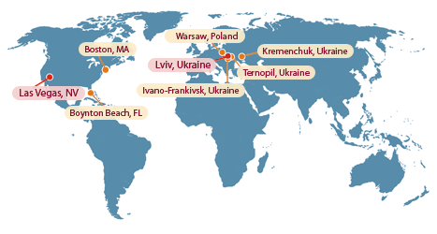
ELEKS Global Locations
Notes:
The company’s Ukrainian headquarters and the main engineering facilities are located in Lviv, Ukraine and its US headquarters are in Las Vegas, Nevada. ELEKS also has representative offices in Boston, MA, Boynton Beach, FL and Warsaw, Poland. Four software engineering centers, as well as the large localization division and web solutions group are based in Ukraine.

Slide 19
ELEKS Services and People
Services & Solutions
Product Development
IT Outsourcing / Team Extension
Software Testing and QA
Full-Cycle Localization Services
Turnkey Solutions for Government
Solutions for SMB
Web Design & Portal Solutions
People
470 IT professionals – and growing
High retention rate of skilled resources
University degree holders - 85%
PhDs - 4%
Fluent English - 55%
Microsoft, Sun, Oracle, and IBM certified professionals
Notes:
ELEKS Software specializes in software application development, independent testing and quality assurance services, full-cycle software and documentation localization and web portals.

Slide 20
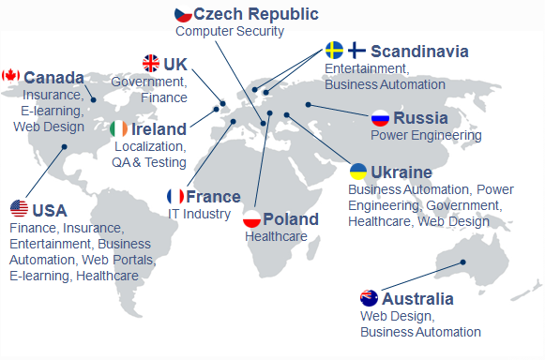
ELEKS Software’s Customer Geography
Notes:
ELEKS customers are located in various countries and continents.

Slide 21
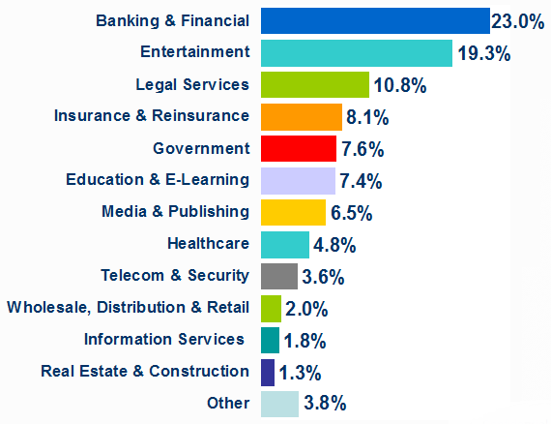
Industries Serviced
Notes:
The company has a diverse customer base. The main verticals that Eleks Software has been servicing are Banking, Financial, Entertainment, Legal Services, Insurance and Re-insurance, Government and other.

Slide 22

Sample Customers
Notes:
Shown on this slide are sample customers of ELEKS Software, among them – large corporations and Fortune 500 companies. The majority of them are returning and long-lasting customers, with some the company has been working for over ten years.

Slide 23
Thank you for attention!
ELEKS Software Contacts
World Headquarters /
Main Engineering Campus
7g Naukova St.
Lviv 79060, Ukraine
phone: +38 032 297-1251
fax: +38 032 244-7002
U.S. Headquarters
701 North Green Valley
Parkway, Suite 200
Henderson, NV 89074
phone: +1 866 588-0113
phone/fax: +1 702 433-4779
EleksInfo@eleks.com
Notes:
Thank you for your attention and I hope you enjoyed my presentation about Ukraine, its IT industry and Lviv as one of its largest centers.

